Slide 1
SOLARSAFE – Heating Element
James Edwicker, Zac Heggie, Josh Tuckwell

Slide 2
Context
Roughly 4.5 billion people and 1/4 of the world's food crops affected by Aflatoxin contamination.
Disproportionately impacts smallholder farmers.
Aflatoxin causes several billion dollars annually in crop losses, increased health care costs and trade restrictions.
Contamination is amplified by poor drying practices, when maize retains moisture or is exposed to rain.

Slide 3
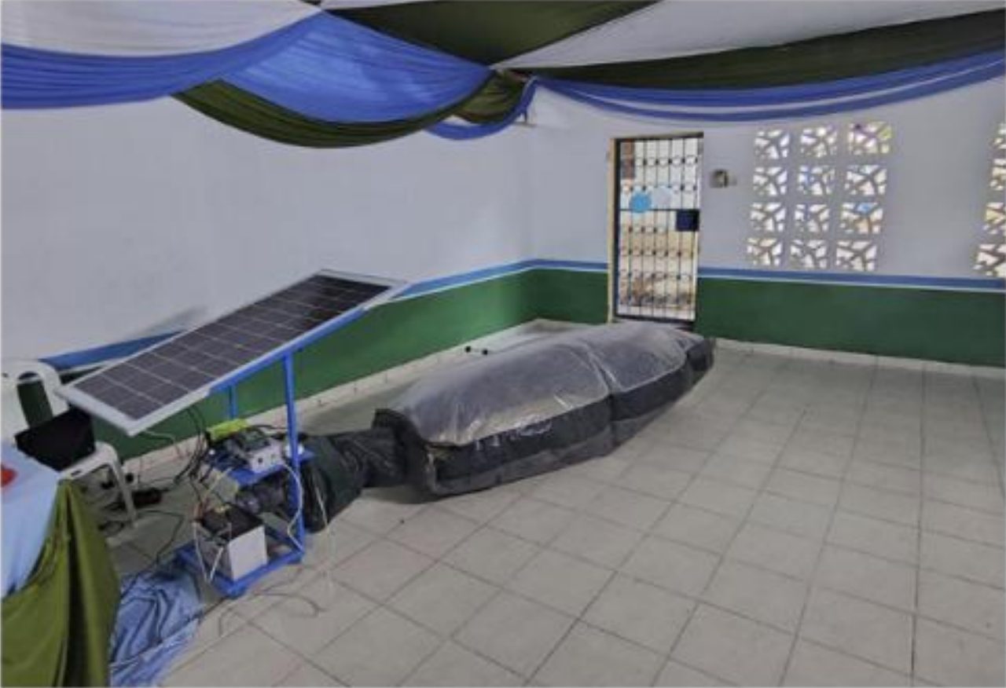
Existing Product
Solar Cell
Inflated Bag
Controller
Fan and Motor
Battery

Slide 4
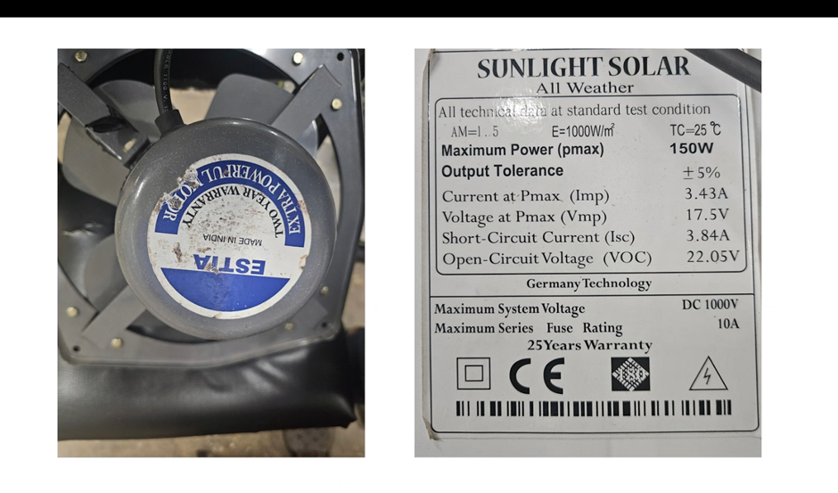
Existing Product

Slide 5
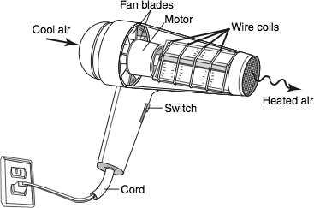
Development ideas
Add a heating element to increase the temperature of the drying air
Want to investigate the following methods:
Using the fan motor heat.
Using heating elements like those used in a hair drier to control how much energy is used to heat the incoming air.
Mirrors to focus the sun’s energy onto material.
Using thermal battery concepts to bypass inefficiencies in battery storage for nighttime heating.
Methods of managing energy harvested in the day to retain enough for nighttime running.

Slide 6
Solution Evaluation in Wider Context
Likely to be shared by an entire community or co-operative.
Relatively short period of time for all the members of the community to extract and treat their maize.
Aflatoxin normally enters the maize from the soil when first dried in the field.
Adding heat improves effectiveness and speed of drying.
Running at night increases quantity of maize dried per day.
The previous two points are would allow the machine to be used by more people.
Better drying improves food quality for reaching health safety standards.
Better health standards increases the value of the maize.

Slide 7
Project Management
Our Strengths
Josh and James have mechanical/aero experience
Zac has electrical/control experience
All have strong industry experience
Our Weaknesses
All lean towards perfectionism
Frugal innovation comes less naturally
Our Roles
Josh – lead communicator with Benard in Kenya
James – Project Lead
Zac – Electronics Lead
Small group so design and modelling can be a joint effort without compromising efficiency
Skills Required
CAD design for 3D printing
Metal working (bending, fixing, welding)
Circuit design and construction (LTSpice, Soldering)

Slide 8
Development Timeline
Define scope – 19/05/26
Propose basic concepts – 21/05/26
Test concepts to find best viable solution – 01/06/26
Create a further developed concept – 08/06/26
Calculate effectiveness at the product level – 11/06/26

Slide 9
Estimated Costing
Test motor: ~£10
Test fan of equivalent size: ~£5 if printed
Fan ducting: ~£5 printed
Control elements: ~£5
Sensing elements: ~£5
Heating elements: ~£10
Thermal battery: ~£40
Exchange fins: ~£2 aluminium material

Slide 10
Risk Assessment
General Hazard | Specific Hazard | Risk | Risk Level | Mitigation
Dyson Centre Equipment | Hand Tools | Bruising and Minor Cuts | Low | Always work with a partner. Know first aid kit and technician locations. Only use tools in the ways designed.
Dyson Centre Equipment | Heavy Machinary | Serious Bodily Harm | High | Do machine training if available. Know first aid kit and technician locations. Keep a clear working area around the machine. Know emergency stop location if available.
SOLARSAFE Heating Elements | Physical Contact with Hot Elements | Burns | Moderate | Design and use a shroud when using heat. Keep a clear area around the element when on and cooling.
SOLARSAFE Heating Elements | Material Contact with Hot Elements | Fire or Harmful Gas Release | Moderate | Inspect the elements for debris before turning on. Keep a clear area around the element when on and cooling.
SOLARSAFE Electrical Elements | Short Circuiting | Damage and Burns to Skin | Moderate | Use a second opinion on construction before first powering on. Keep circuity clean of debris. Use insulators and isolators where possible
SOLARSAFE Electrical Elements | Exposed Conductors | Electrocution | Low | Always work with a partner. Know first aid kit and technician locations. Avoid handling exposed circuitry when power

Slide 11
Contingency
Heating idea fails: pivot to improving even drying of the maize.
Failure in cost overrun: pivot to using our design for research and data collection for future attempts.
Energy demands fail: pivot to minimise daytime drying time to increase throughput this way.

